Slide 1
Menhaden Distribution and Movement in the Gulf of Mexico
Presented by Olivia Floyd

Slide 2
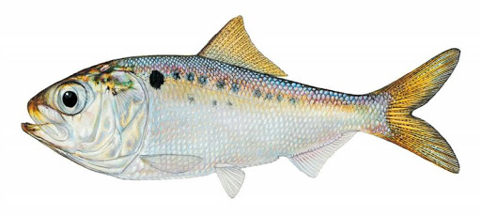
Introduction: Gulf Menhaden (Brevoortia Patronus)
One of the largest fisheries by landing tonnage in the U.S.
Estuarine-Pelagic coupled; overwinter and spawn off-shore, more onshore during the summer
Filter feeders; detritus, amorphous matter, phytoplankton and zooplankton
Keystone prey species for secondary consumers; rich in fats and nutrients

Slide 3
Key Question: How does the distribution of Menhaden biomass in the Gulf of Mexico change seasonally?

Slide 4
(1): Pre-Processing in R

Slide 5
Steps 2-6: Create Feature Class, Project Coordinate System, Define Spatial Relationships
Used select by attributes to isolate Menhaden data by seasonality
(2) Created a new shapefile and (3) used edit polygon feature to create a polygon of the survey area for both the fall distribution and the summer distribution.
(4) Projected feature class into Albers Equal Area projection so that geometry could be calculated
(5) Used vector analysis (clip) to isolate overlapped portions of both survey areas, then used union to create a compiled total survey area. (6) Used calculate geometry for both and divided the overlapped survey area by the combined survey area to get a measure of percent overlap (72.8%)

Slide 6
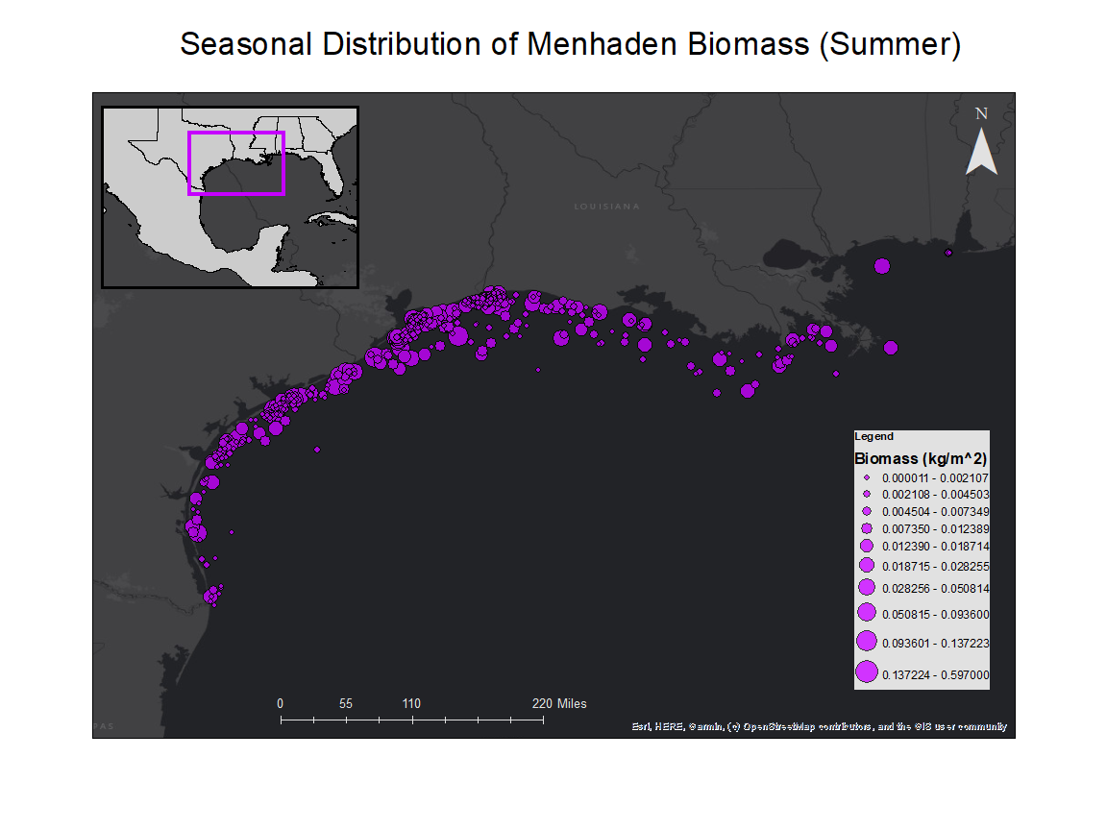

Slide 7
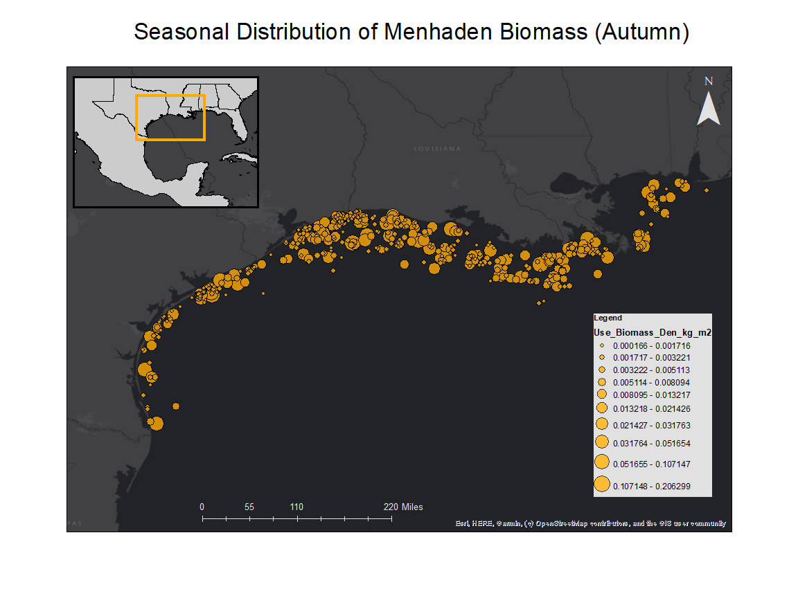

Slide 8
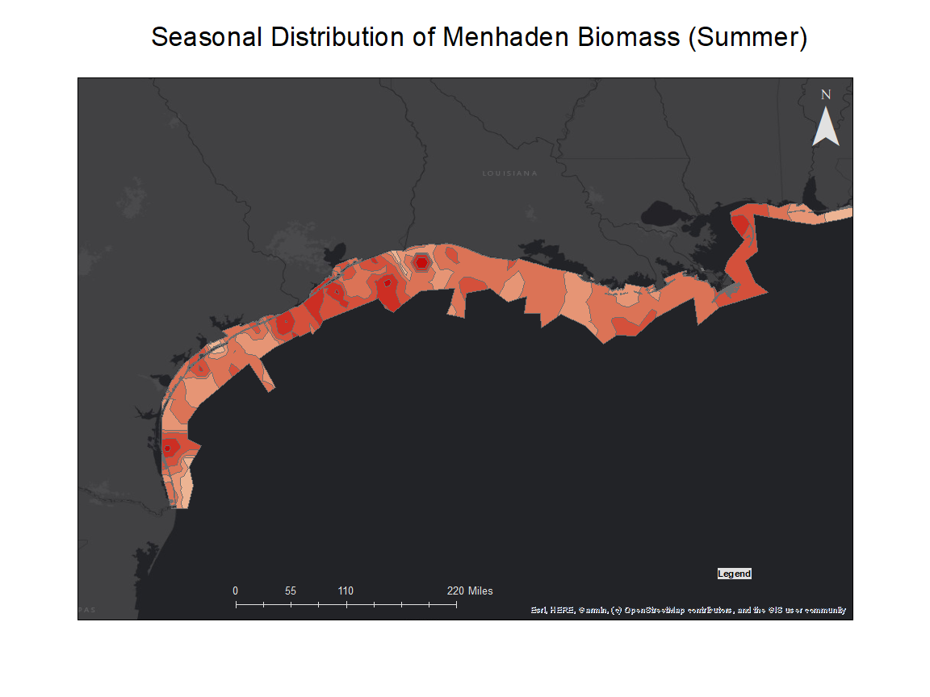
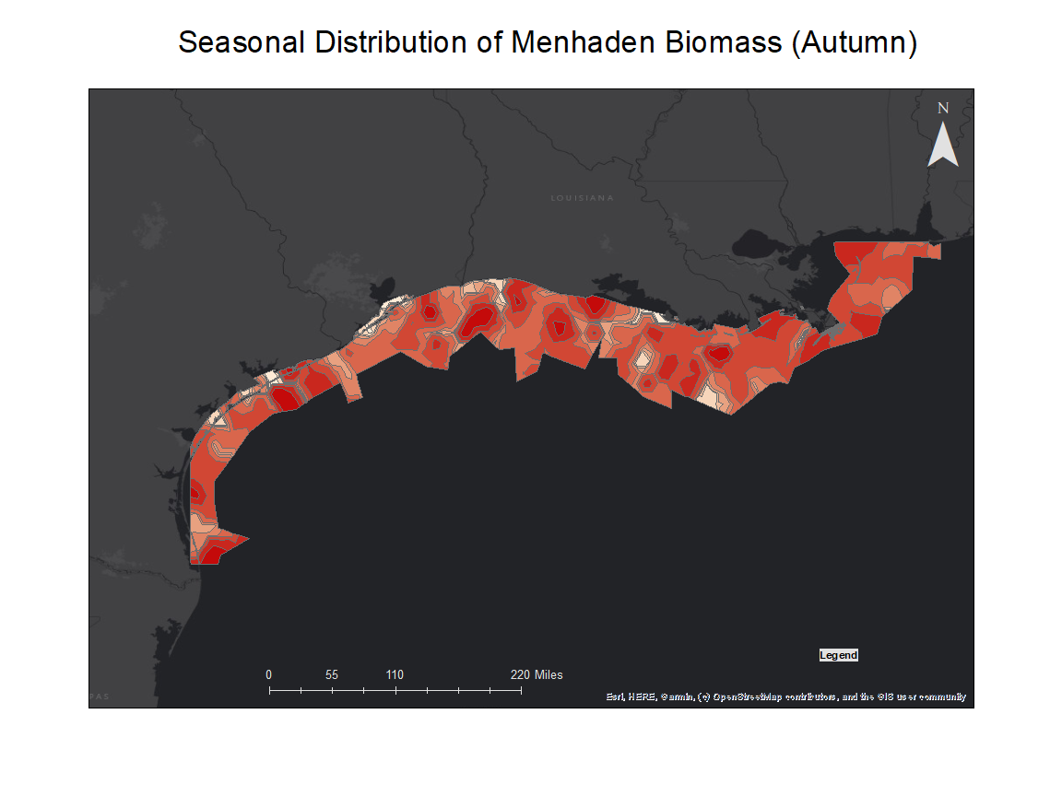
(8) Interpolation

Slide 9
Why would there be a westward shift of Menhaden biomass in the autumn?

Slide 10
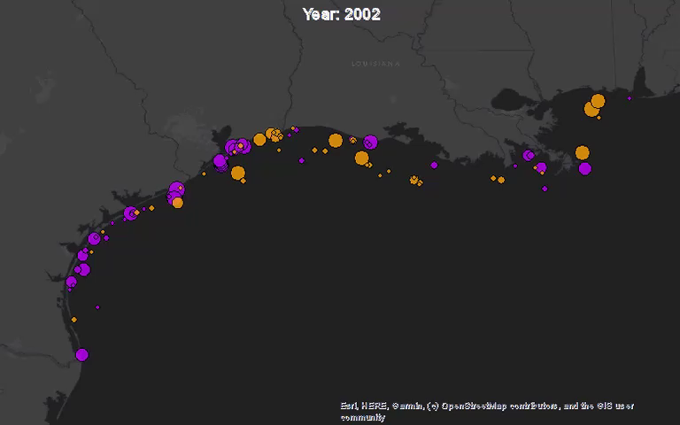
Time-lapsed Data: Patterns in distribution of Menhaden between 2002 and 2017
72.8% overlap of survey area
(7) Time-enabled Data

Slide 11
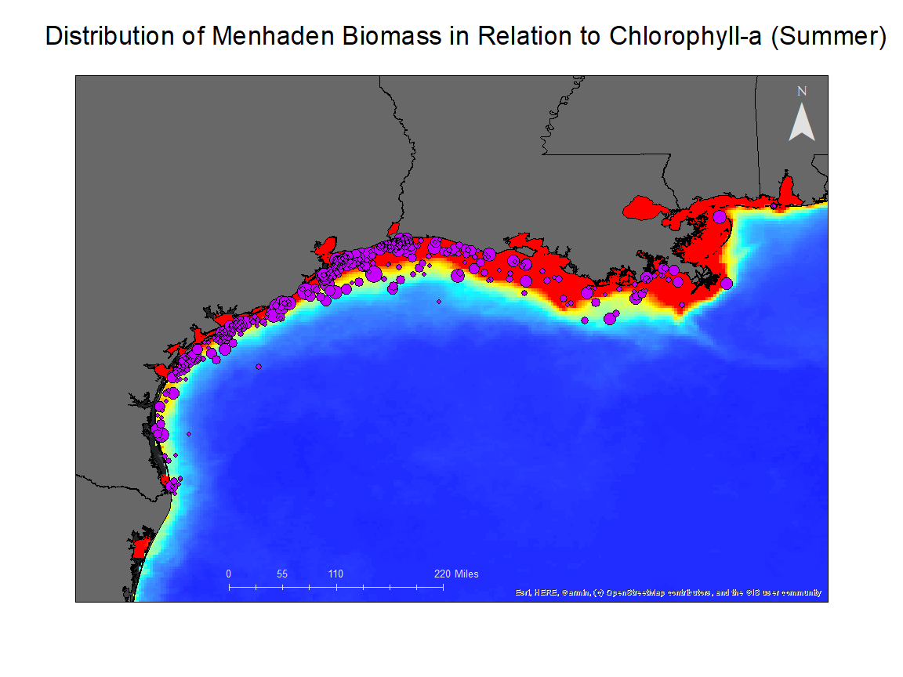
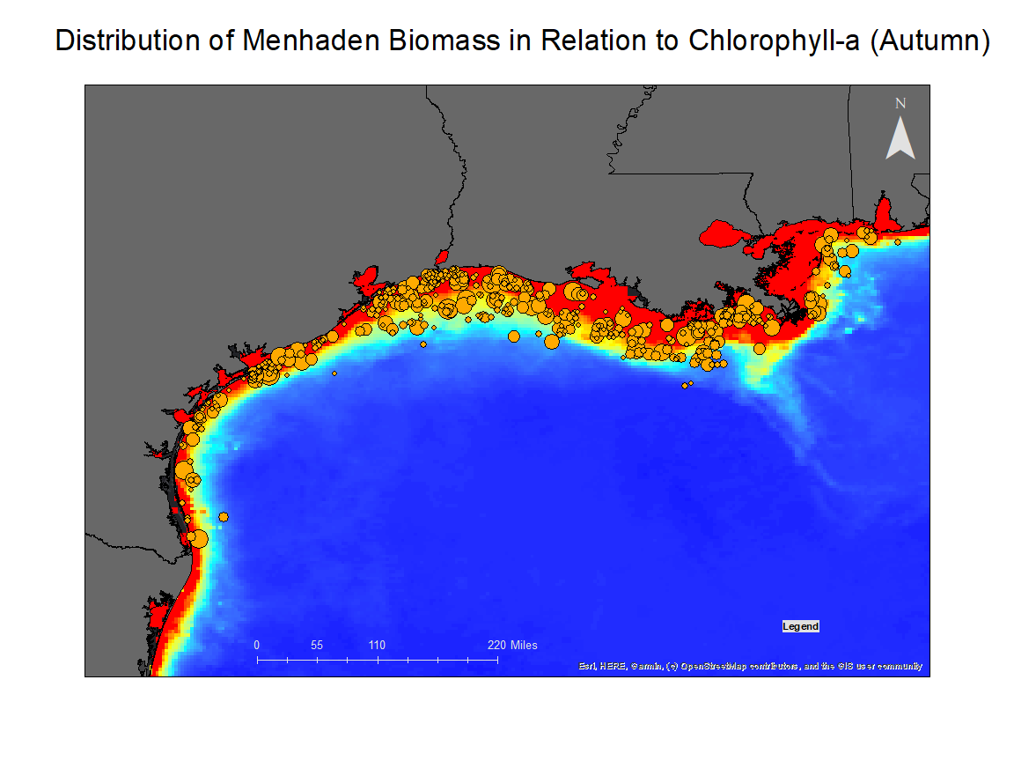
Investigating phytoplankton as a potential control on Menhaden distribution
(9) NetCDF and (10) Raster Data

Slide 12
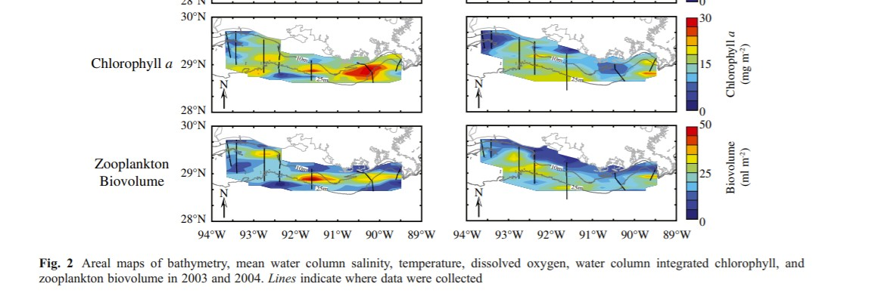
2003
2004
*Sampled during July & August
Figure from Roman et al. 2012

Slide 13
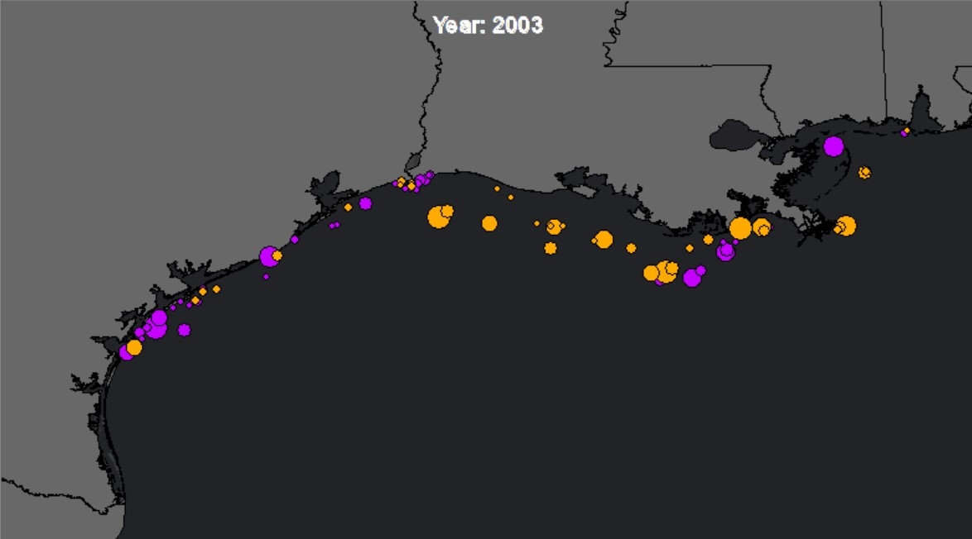
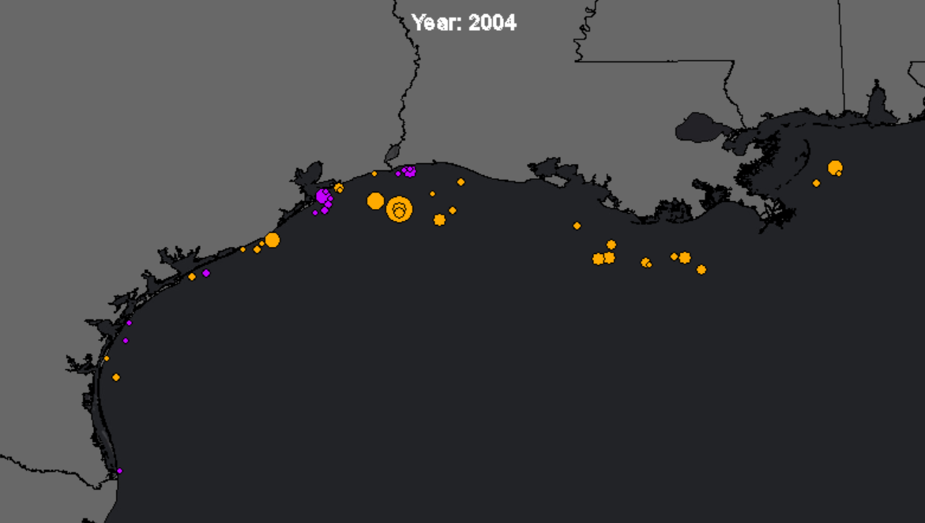
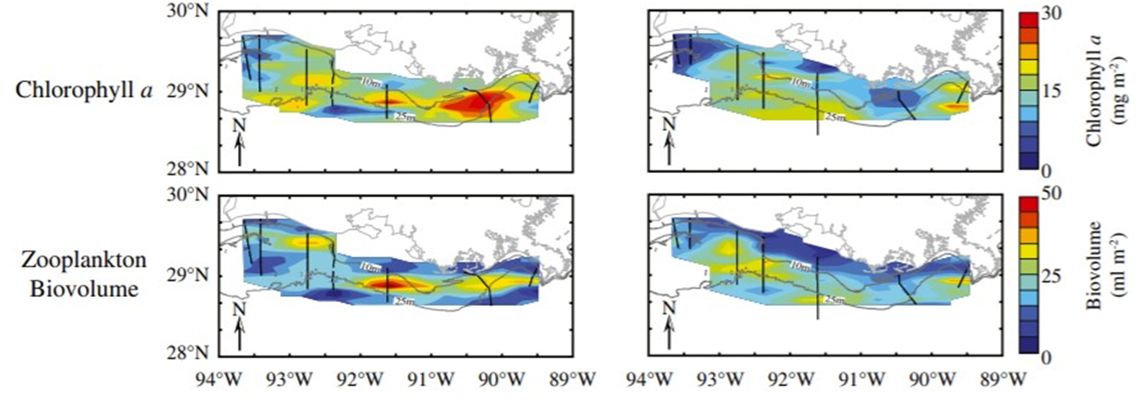

Slide 14
What could explain these trends then?
Other feeding habits/food availability?
Hypoxia/dead zone avoidance?
Salinity?
Predator evasion?

Slide 15
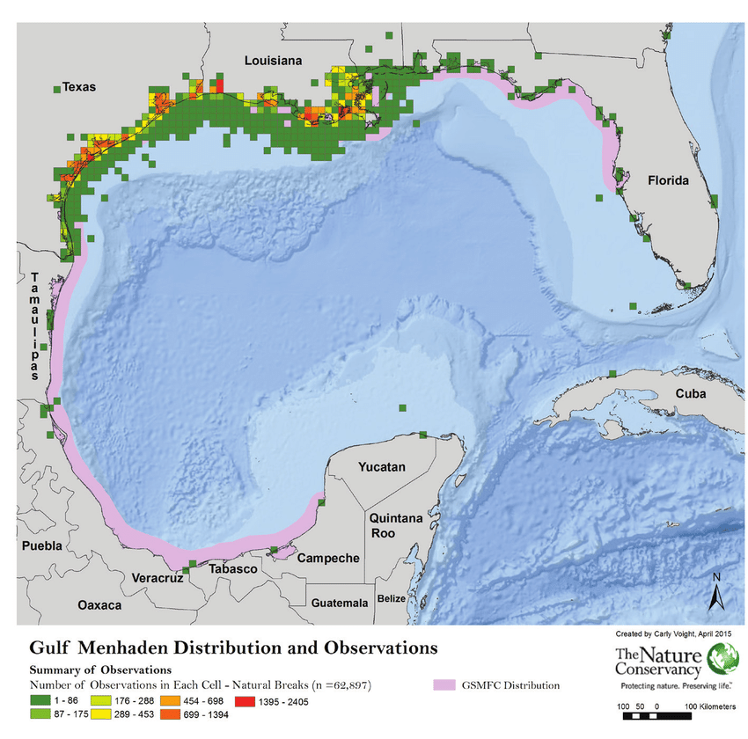
Adults move from deeper (winter) to shallow (summer) seasonally. Eat plankton (zoo- and phyto-)
Larval fish move from continental shelf to estuaries where they stay spring-fall eating phytoplankton, migrating offshore for the winter as they reach adulthood
It is speculated in literature that menhaden migrations are triggered due to the interactions of nutritional and climatic effects on the availability of food in the estuaries and offshore environments of the northern GoM
Diet also appears to be controlled by gill raker development, and thus the type of plankton eaten depends on particle size more that species group.
From Migratory Species in the Gulf of Mexico Large Marine Ecosystem. Jorge Brenner, Carly Voight and David Mehlman

Slide 16
If Menhaden are after phytoplankton though, why do Menhaden concentrate around the western GoM and not the outlet of the Mississippi in the summer?

Slide 17
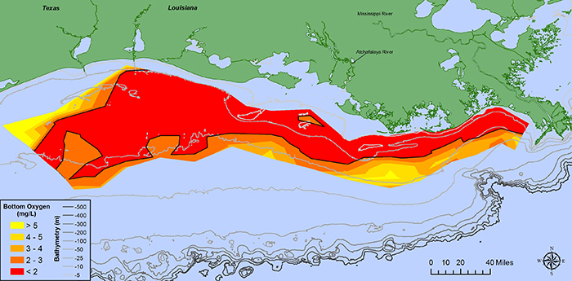

Slide 18
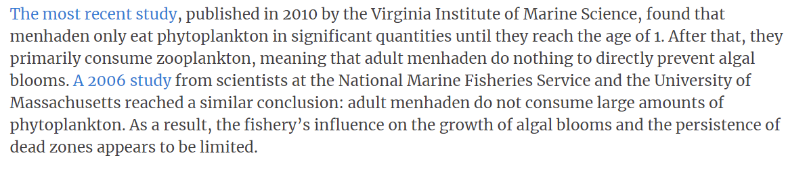
Menhaden and the Dead Zone
From “ON DEAD ZONES AND MENHADEN, RFA’S JIM HUTCHINSON IGNORES THE FACTS”

Slide 19
Data Limitations
Samplings only performed in June, July, October and November.
No data on life stage of fish captured; i.e. small biomass could be lots of young, small fish or a few large fish but we aren’t able to interpret this.
Sampling bias; No data from within the estuaries, especially around Lake Pontchartrain
There were no annually compiled seasonal averages for the raster data– though visually the trends were pretty consistent

